Slide 1

Working smarter, faster and more securely in R

Slide 2
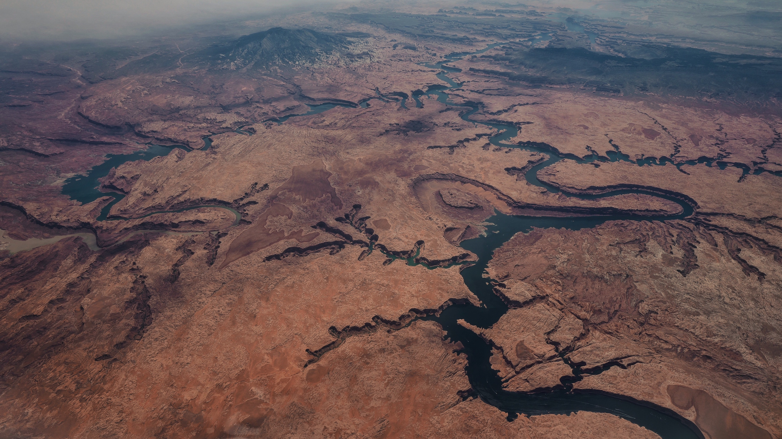





Bayesian Adaptive Design for Sampling on Stream Networks Katie Buchhorn, PhD student
Prof James McGree
D Prof Kerrie Mengersen
Dr Paul Wu
Dr Edgar Santos Fernandez

Slide 3
Components of adaptive design
Model
Data
Utility
Search
Y = bX + z + e
y1, y2, .. x1, x2…
U(d) = minimal uncertainty
Maximise over all d in D

Slide 4
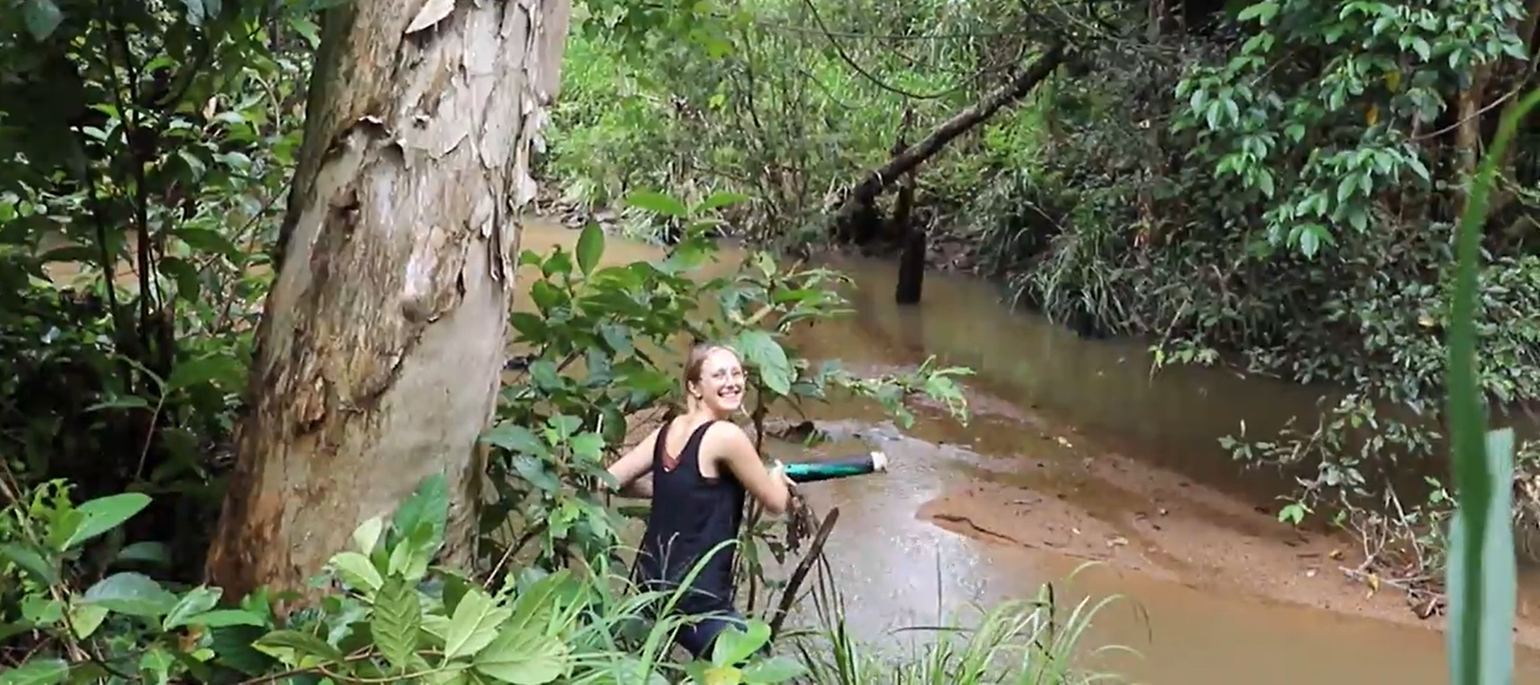
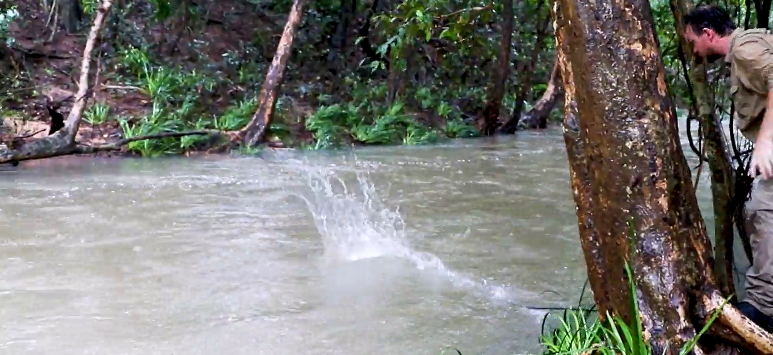
Applications of adaptive design
Ecological monitoring (when, where and what type of sensors to deploy)
Falk, Matthew G., James M. McGree, and Anthony N. Pettitt. "Sampling designs on stream networks using the pseudo-Bayesian approach." Environmental and ecological statistics 21.4 (2014): 751-773.
Big data (what subset of data to look at)
Drovandi, Christopher C., et al. "Principles of experimental design for big data analysis." Statistical science: a review journal of the Institute of Mathematical Statistics 32.3 (2017): 385.
Pharmacokinetics (when to take samples from patients)
Al-Banna, Mahir K., Andrew W. Kelman, and Brian Whiting. "Experimental design and efficient parameter estimation in population pharmacokinetics." Journal of pharmacokinetics and biopharmaceutics 18.4 (1990): 347-360.
….model discrimination ,etc.

Slide 5
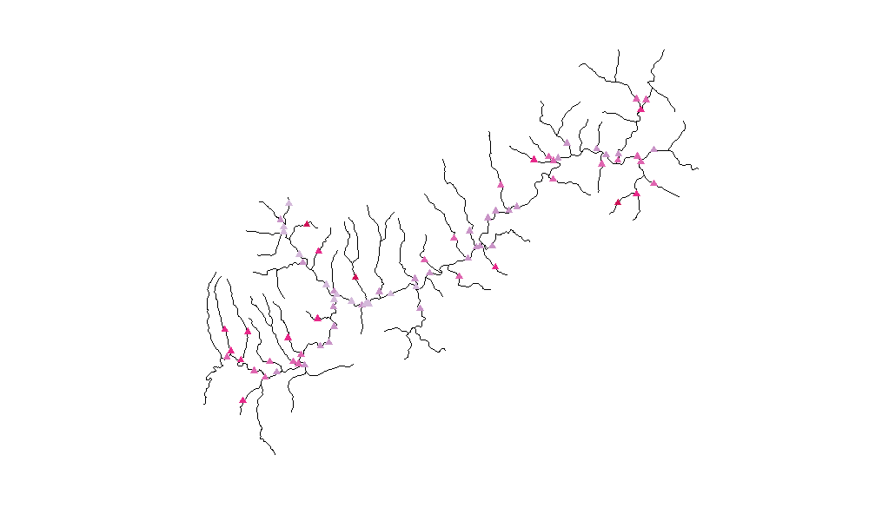
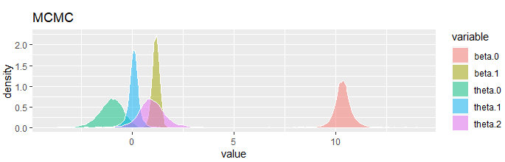
Water temp ~ θ1 Air temp + θ2 Slope + θ3 Drainage + θ4 Elevation

Slide 6
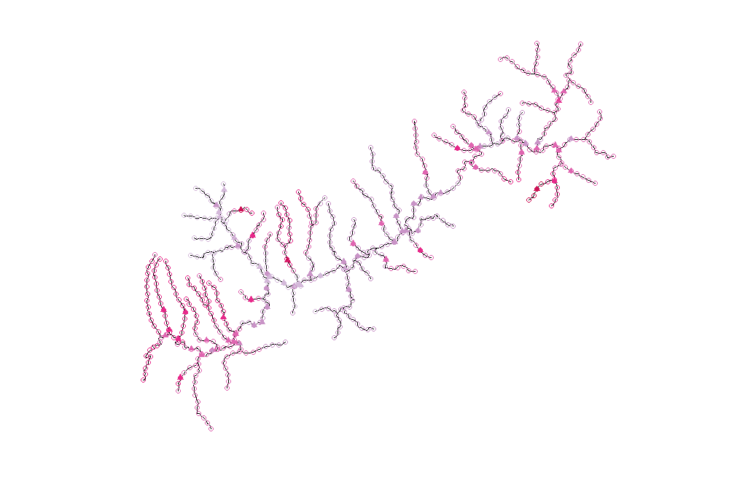
Slope interpolation using 3 nearest neighbours

Slide 7
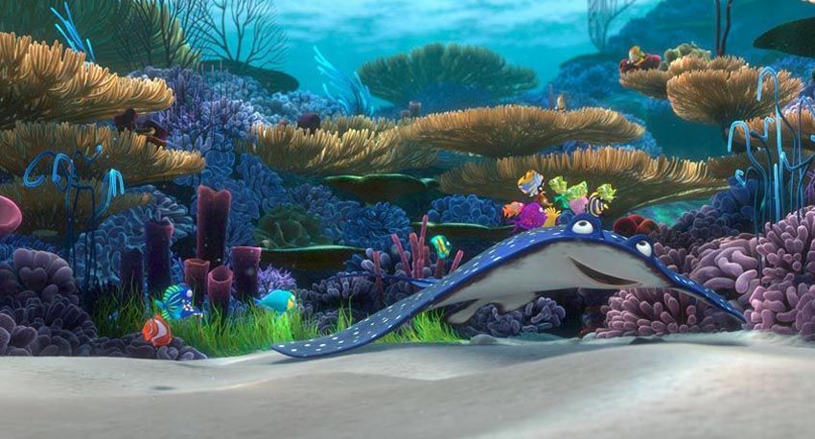
Working smarter, faster and more securely in R
2. Modularising code (10 mins)
3. Sending jobs to HPC (5 mins)
1. Using git with Rstudio (10 mins)
P(coral) ~ θ1 Depth

